Slide 1
Iterator Design Pattern
Behavioral Design Pattern Based on Design Patterns – Erich Gamma, Richard Helm, Ralph Johnson, John Vlissides
Prepared by: Samuel Abera Mekonn Course: Software Architecture

Slide 2
Iterator Design Pattern
Intent:
Provide a way to access the elements of an aggregate object sequentially without exposing its underlying representation.
Design Patterns (GoF)
✔ Access elements without exposing structure ✔ Provide a uniform traversal interface ✔ Separate traversal from collection

Slide 3
Iterator Design Pattern
Motivation
In complex systems (e.g., document editors):
Need to traverse document structure
Support multiple traversal algorithms
Avoid tight coupling between algorithms and structure
Solution:
Encapsulate traversal behavior inside an Iterator object.

Slide 4
Iterator Design Pattern
Definition
The Iterator Pattern:
Provides sequential access to elements
Hides internal representation
Allows multiple traversal strategies
Lets collection and traversal vary independently
It is classified as a Behavioral Pattern.

Slide 5
Iterator Design Pattern
Use Iterator When:
You need multiple ways to traverse a collection
You want a uniform interface for different data structures
You want to hide the internal representation of a container
Traversal logic should not be part of the collection class

Slide 6
Structure
Participant | Role in the System
Iterator | Defines traversal methods hasNext() and next()
NameIterator | Implements the Iterator and performs traversal of names
Container | Interface that declares getIterator()
NameRepository | Stores the collection of names and creates the iterator

Slide 7
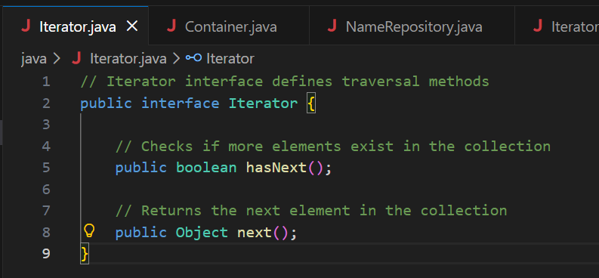
Java Built-in Iterator
All Java collections provide:
Iterator<E> iterator();
Examples:
ArrayList
HashSet
HashMap (keySet().iterator())

Slide 8
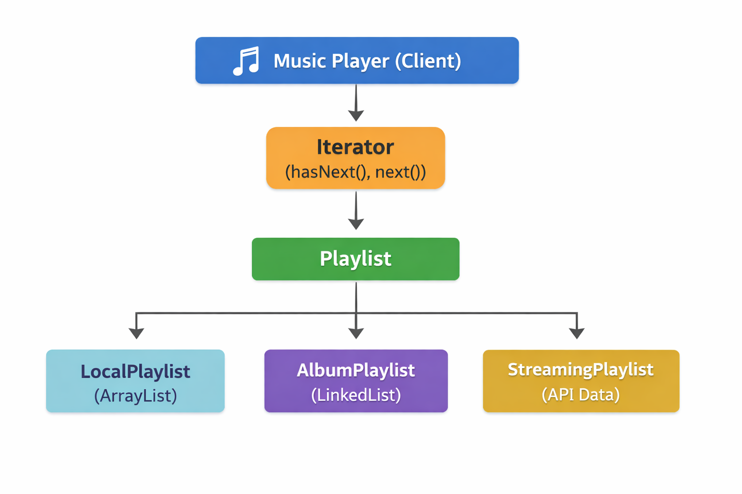
Real-World Example

Slide 9
Without Iterator (Bad Design)
If try to access songs directly:
for(int i = 0; i < playlist.size(); i++){ play(playlist.get(i)); }
This assumes the playlist is: ArrayList
But if songs come from a streaming API, there may be:
no size()
no get(i)
Result:
❌ The player code becomes tightly coupled to the data structure ❌ Changing the source breaks the program

Slide 10
With Iterator Pattern
Using the Iterator Pattern, the player accesses songs like this:
Iterator songIterator = playlist.getIterator(); while(songIterator.hasNext()){ Song song = songIterator.next(); play(song); }
Now the player only knows two methods:
hasNext()
next()
It does not care how the songs are stored internally.
This separates the playback logic from the data structure.

Slide 11
Consequences
Advantages
Encapsulation of internal structure
Multiple traversal algorithms
Clean separation of concerns
Supports concurrent iteration
Disadvantages
✖ Adds additional classes ✖ Slight increase in system complexity

Slide 12
Real-World Usage
Iterator Pattern is widely used in:
Java Collections Framework
Database result set processing
File system traversal
Tree and graph traversal
Streaming APIs
It is a fundamental pattern in modern software systems.

Slide 13
Conclusion
Iterator Pattern
Behavioral design pattern
Separates traversal from collection
Provides flexibility and extensibility
Widely implemented in Java and .Net
The Iterator pattern demonstrates how object-oriented design promotes modularity and maintainability.

Slide 14
Conclusion
10Q

